Slide 1
Morse Code
Converter using
Python
Submitted by: Kartik (2210990485)
Submitted to:
Mr. Tushar

Slide 2
Intro to Morse code
Introduction to Morse Code
History and Usage
Morse Code is a method used in telecommunication to encode text characters as sequences of two different signal durations, called dots and dashes.
It was developed in the 1830s and 1840s by Samuel Morse and Alfred Vail to be used with their invention, the telegraph.
Morse Code was widely used for long-distance communication before the invention of the telephone.
Encoding and Decoding
In Morse Code, each letter of the alphabet, as well as numbers and punctuation marks, is represented by a unique combination of dots and dashes.
The length of the dots and dashes determines the duration of the signal.
To encode a message, each character is translated into its corresponding Morse Code sequence.
To decode a message, the Morse Code sequence is translated back into the original text character.
Morse Code can be transmitted using sound, light, or other forms of signals.

Slide 3
Understanding the Python Programming Language
Overview of Python
Python is a high-level programming language knowfor
its simplicity and readability. It has a clean and easy-to-
understand syntax, making it an ideal choice for
beginners and experienced programmers alike.
Features of Python
Interpreted: Python code is executed line by line, making it easy to test and debug.
Object-Oriented: Python supports object-oriented programming, allowing for the creation of reusable and modular code.
Versatile: Python can be used for various applications, including web development, data analysis, and machine learning.

Slide 4
Building a Morse Code Converter
Building a Morse Code Converter
Python can be used to build a Morse Code Converter by leveraging its string manipulation capabilities and control flow statements. By mapping each character to its Morse Code equivalent, you can convert text into Morse Code and vice versa.
Example Code
Here is an example code snippet that demonstrates how to implement a simple Morse Code Converter in Python:
# Define the Morse Code dictionary
morse_code = { 'A': '.-’,
'B': '-...’,
'C': '-.-.', ... }
# Function to convert text to Morse Code
def text_to_morse(text):
morse = '' for char in text:
If
char.upper() in morse_code: morse += morse_code[char.upper()] + ' ‘
else:
morse += ' ‘

Slide 5
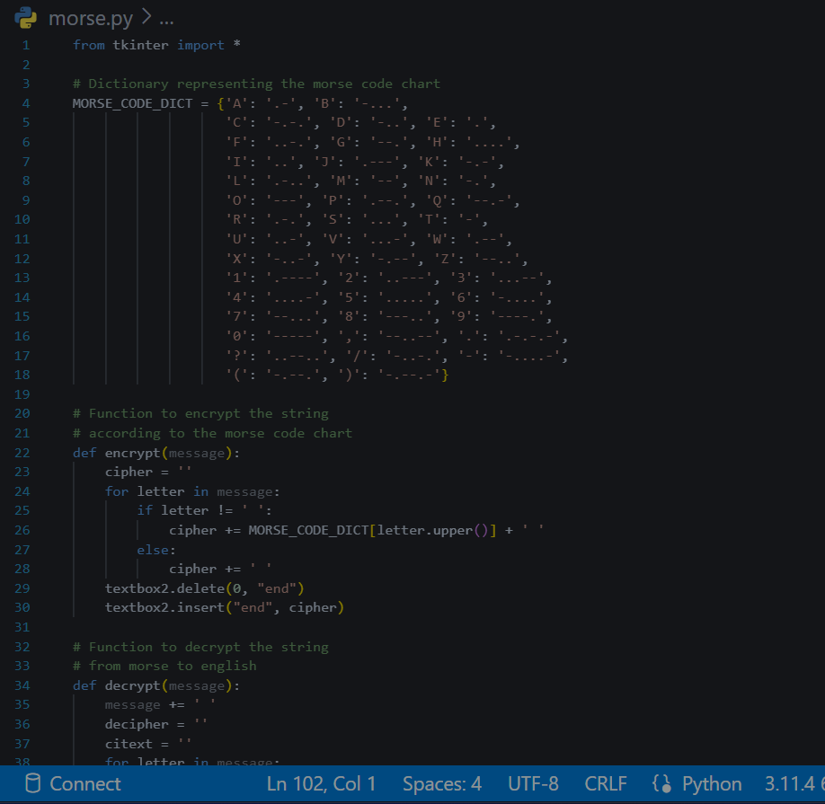
Code

Slide 6
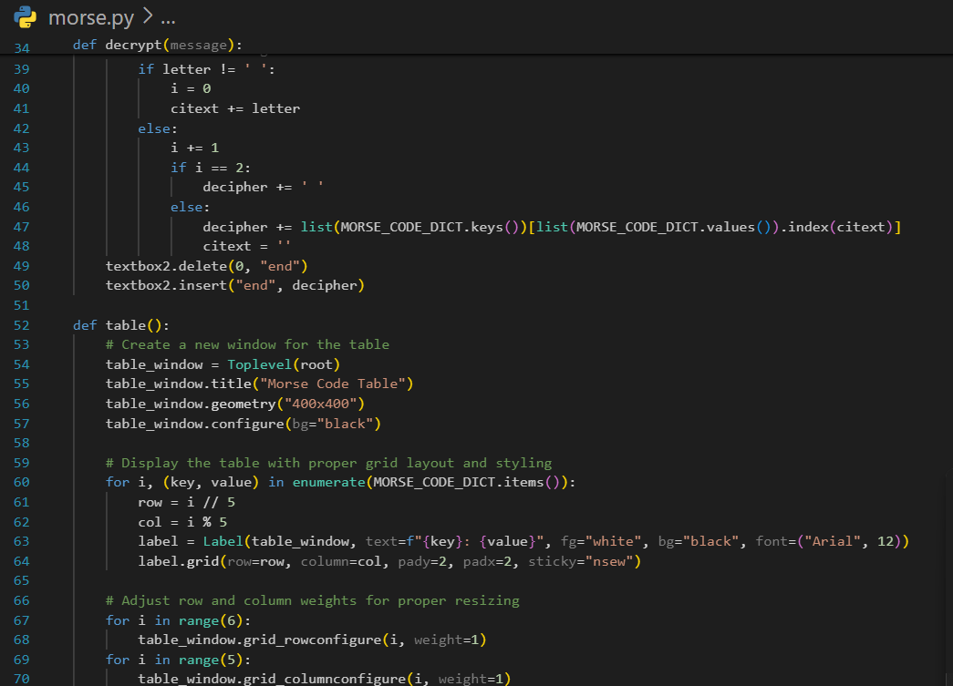
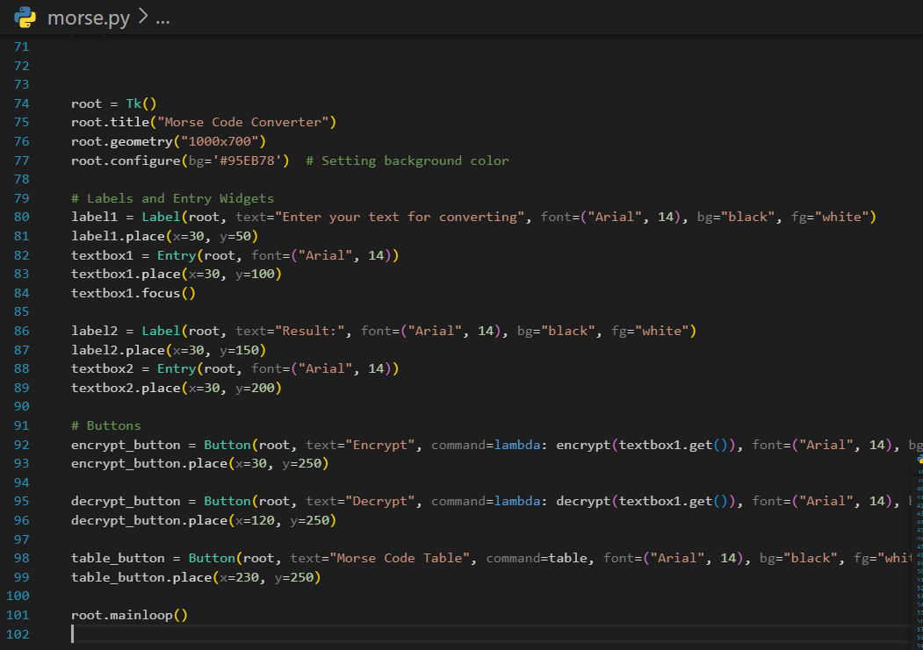
Code

Slide 7
Building the Morse Code Converter
Step 1: Define the Morse Code Dictionary
Create a dictionary that maps each letter or character to its corresponding Morse Code representation.
Step 2: Accept User Input
Prompt the user to enter a message they want to convert to Morse Code.
Step 3: Convert the Message
Iterate through each character in the user's input.
Look up the corresponding Morse Code representation for each character in the Morse Code dictionary.
Append the Morse Code representation to a new string.
Step 4: Display the Converted Message
Print the converted Morse Code message to the console.
Step 5: Optional - Play the Morse Code
Use a library like 'pyttsx3' to convert the Morse Code message into audio and play it back to the us

Slide 8
Importance Of Testing
Importance of Testing
Testing is a crucial step in the development process as it helps ensure that the Morse Code Converter functions correctly and produces accurate results. It helps identify any errors or bugs in the code, ensuring that the final product meets the desired requirements.
Common Testing Techniques
Unit Testing: This involves testing individual components or units of the code to ensure they work as expected. It helps identify any errors or issues in specific functions or modules.
Integration Testing: This tests how different components of the code work together. It ensures that the Morse Code Converter functions correctly as a whole.
Functional Testing: This tests the overall functionality of the Morse Code Converter, ensuring that it performs the desired tasks accurately.
Debugging Strategies
Logging: Adding logging statements in the code helps track the flow of execution and identify any issues or errors.
Debugging Tools: Making use of debugging tools, such as breakpoints and step-by-step execution, helps identify and fix errors in the code.
Error Handling: Implementing proper error handling techniques, such as try-except blocks, helps catch and handle any exceptions or errors that may occur during runtime.
Code Reviews: Conducting code reviews with peers or team members helps identify any potential issues or bugs in the code.
.

Slide 9
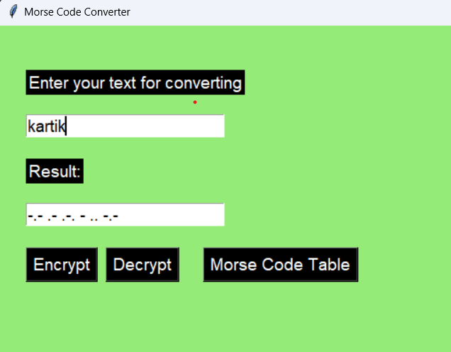
Demo: Morse Code Converter in Action
To demonstrate the Morse Code Converter in action, we will show how the program accepts user input and converts it into Morse Code.
User Input: The program prompts the user to enter a message in English.
Conversion: The program converts the English message into Morse Code using the specified mapping.
Output: The program displays the Morse Code representation of the input message.
Let's see the Morse Code Converter in action!
User Input
Kartik
Output
-.- .- .-. - .. -.-

Slide 10

Conclusion and Next Steps
Conclusion and Next Steps
Conclusion
In this presentation, we explored the process of building a Morse Code Converter using Python. We learned about the basics of Morse code, how to convert text to Morse code and vice versa, and how to implement the conversion logic in Python. By following along with the code examples and explanations, you should now have a good understanding of how to build your own Morse Code Converter.
Next Steps
Now that you have a solid foundation in building a Morse Code Converter, here are some next steps for further exploration:
Expand Functionality: Enhance the Morse Code Converter by adding additional features, such as support for punctuation marks, international characters, or audio output.
Explore Other Python Projects: Take your Python skills to the next level by exploring other interesting Python projects, such as building a chatbot, creating a web scraper

Slide 11
References
Project link-
https://github.com/kartik-mah/morse-code.git

Slide 12
Thank You

